Slide 1
WELCOME

Slide 2
Topic :
Climatic condition due to Deforestation.
Submitted to
SHAILA AHMED
Senior Assistant Professor
Dept. of English AIUB
Presented by group : 5
SM Walid | 23-50005-1
Kawsar Khan | 23-50192-1
Abir Tirtha Das | 23-50228-1
Farhan shahriar Joy | 23-50306-1
Abu Bakkar Siddik | 23-50049-1

Slide 3
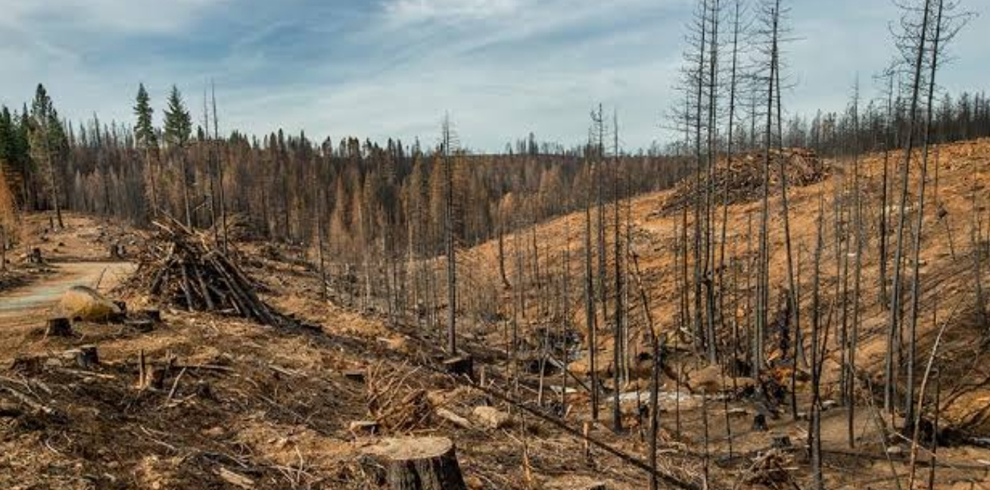
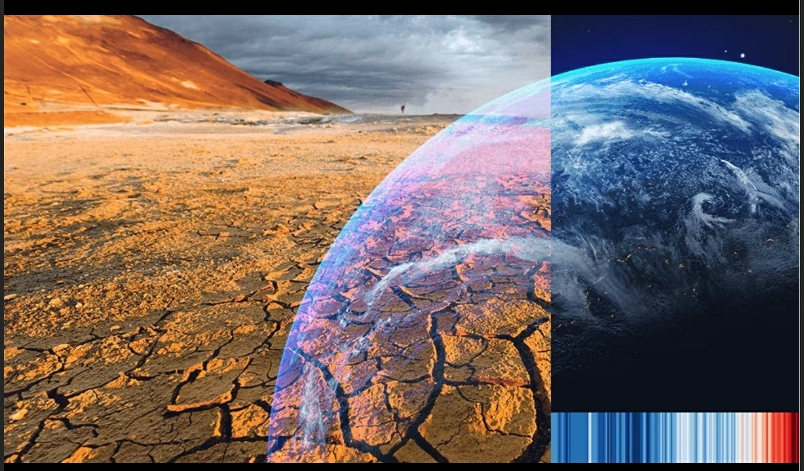
Deforestation and Climatic Change
Cutting down tress randomly.
Weather shifts depends on Temperature and weather patterns.
Weather shifts may be natural or human activities.

Slide 4
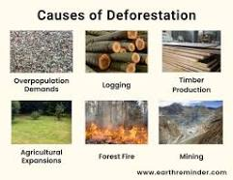
The Reasons for Deforestation:
Logging Industry.
Cattel Farms or Agriculture expansions.
Infrastructure expansions.

Slide 5
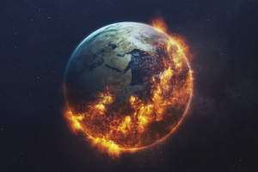
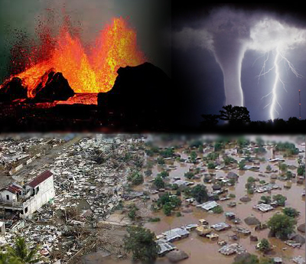
IMPACT OF DEFORESTATION ON CLIMATE CHANGE
Decreasing Number Of Trees
Global Warming
Rise In Sea Level

Slide 6
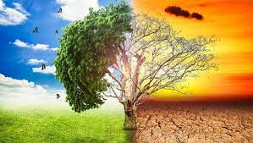
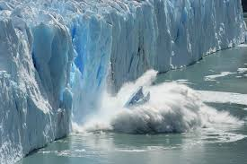
Effects of climate change due to deforestation.
Year after year of record-breaking warmth.
Reduce soil health .
More health risk .

Slide 7
Some Informations From World Resource Institute about Deforestation:
The rate of deforestation.
Global warming due to deforestation.
What we have to do.

Slide 8
Do you have any Questions ?

Slide 9
Thank You

